Slide 1








Data Analyst Capstone Project
NETFLIX EXPLORATORY DATA ANALYSIS
PRESENTING BY

Slide 2

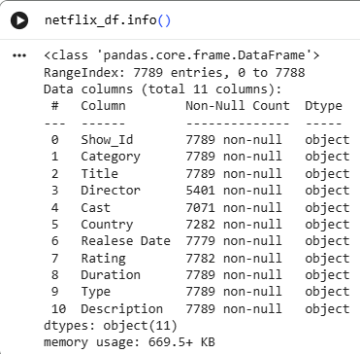
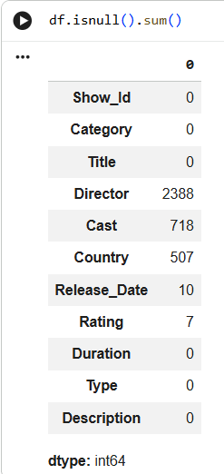

DATA UNDERSTANDING
In this data, we can see that the dataset contains 7,789 rows, with missing values found in Director, Cast, Country, Release_Date, and Rating.
We observed that the Release_Date column is stored as an object (string) data type instead of datetime.
We checked the count of missing values present in the data.
We found that there are 2 duplicate rows in the dataset that need to be removed.

Slide 3
DATA CLEANING
We have replaced the missing values of the Director ,Cast, and Country columns with unknown.
we have converted the data type of Release_Date column to ‘Datetime’ format.
We have removed duplicate rows to ensure data accuracy.
We have extracted another column ‘year’ for our business insight requirement.
And lastly, we have deleted the null values of the columns (Release_Date) and (Rating) as there are in a small numbers.

Slide 4
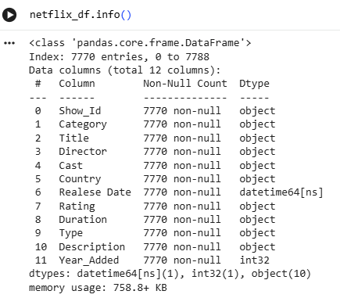
FINAL DATA
Here , we finalized the cleaned data with 7,770 valid records, completely free of missing values and duplicates, and ready for analysis.

Slide 5
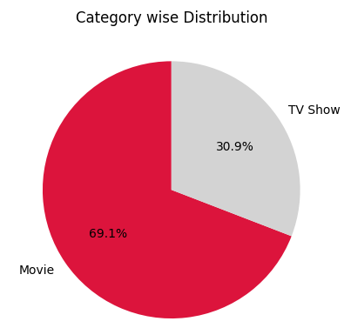
BUSINESS INSIGHTS
Category Wise Distribution
KEY BUSINESS INSIGHTS
Movie Volume Dominance
Movies comprise 69.1% of the catalogue, serving as the core driver for standalone, casual streaming.
TV Show Retention Value
TV Shows account for 30.9% of titles, driving multi-episode binge viewing and long-term retention.

Slide 6
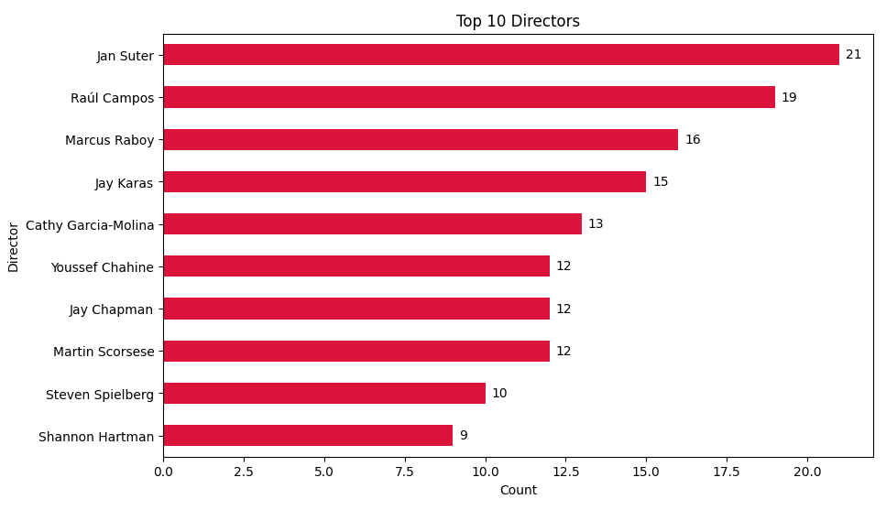
Top 10 Most Featured Directors on Netflix
KEY BUSINESS INSIGHTS
Stand-Up Comedy & Specials Lead the Top Ranks
Jan Suter (21), Raúl Campos (19), and Marcus Raboy (16) top the list because Netflix produces and releases comedy specials at a rapid pace.
.
Global Cinema & Hollywood Legends Add Depth
International directors like Cathy Garcia-Molina (13) alongside iconic Hollywood filmmakers like Martin Scorsese (12) and Steven Spielberg (10) provide a strong mix of global cinema and high-value classic films.

Slide 7
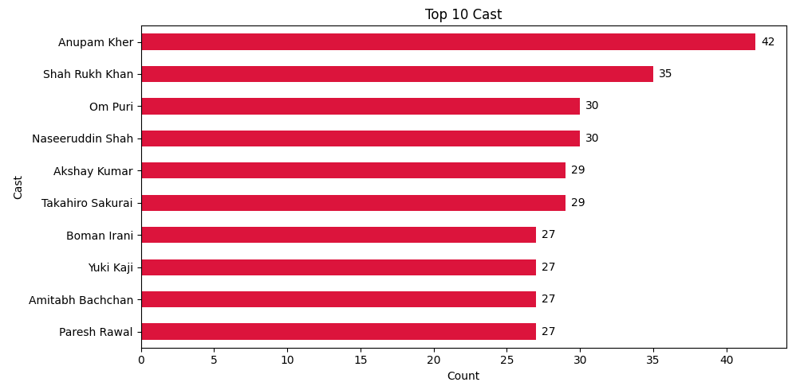
Top 10 Most Featured Actors on Netflix
KEY BUSINESS INSIGHTS
Indian Cinema Dominance
Anupam Kher (42) and Shah Rukh Khan (35) lead alongside Bollywood icons Om Puri (30), Naseeruddin Shah (30), Akshay Kumar (29), Boman Irani (27), Amitabh Bachchan (27), and Paresh Rawal (27) to drive massive South Asian library depth.
.
Global Anime Presence
Japanese voice actors Takahiro Sakurai (29) and Yuki Kaji (27) claim key top-10 spots, highlighting high global subscriber demand for recurring animated series.

Slide 8
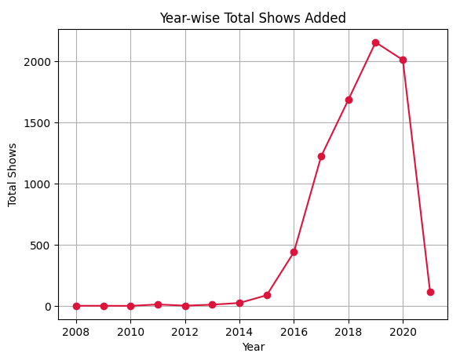
Year Wise Total Shows
KEY BUSINESS INSIGHTS
Peak Additions in 2019
Total content additions peaked in 2019 with over 2,100 titles before Netflix shifted focus toward producing original hits.

Slide 9
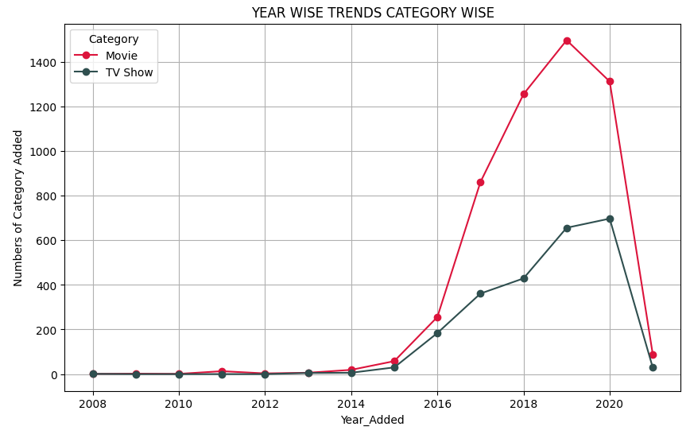
Yearly Content Growth: Movies vs. TV Shows
KEY BUSINESS INSIGHTS
Peak in 2019
Movie additions grew rapidly from 2015 and hit a high of nearly 1,500 titles in 2019 before slowing down.
Steady Rise until 2020
TV shows saw consistent year-over-year growth, peaking in 2020 with around 700 new shows added.

Slide 10
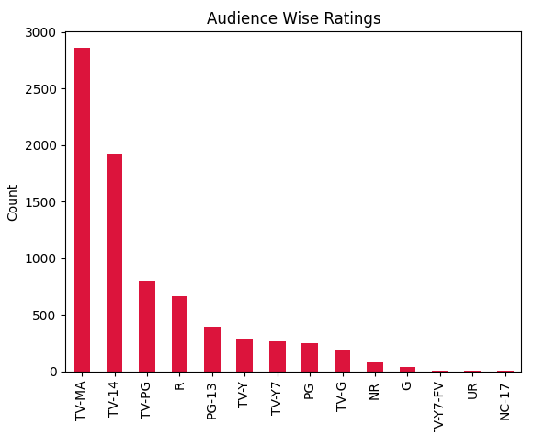
Audience Wise Ratings
KEY BUSINESS INSIGHTS
Targeted at Adults & Teens
TV-MA and TV-14 are the biggest categories, showing Netflix focuses mostly on mature audiences.
Fewer Kids Shows
Pure children's and family ratings (like TV-Y and G) make up only a small share of the catalogue.

Slide 11
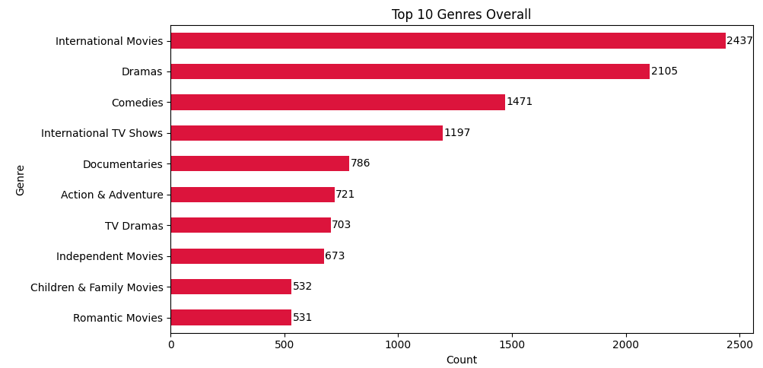
Top 10 Overall Genres
KEY BUSINESS INSIGHTS
Global Drama on Top
International Movies and Dramas lead by a huge margin, proving Netflix relies heavily on story-based content.
Comedy & Documentaries Follow
Comedies and Documentaries hold strong numbers to offer broad entertainment variety.

Slide 12
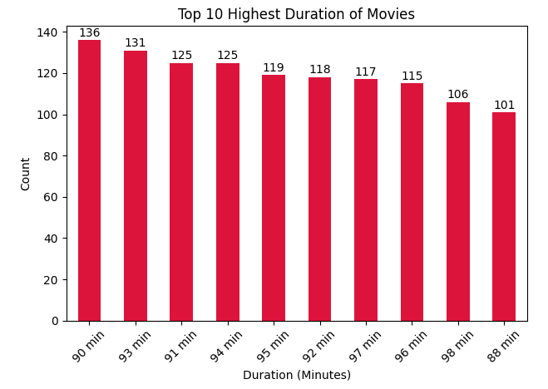
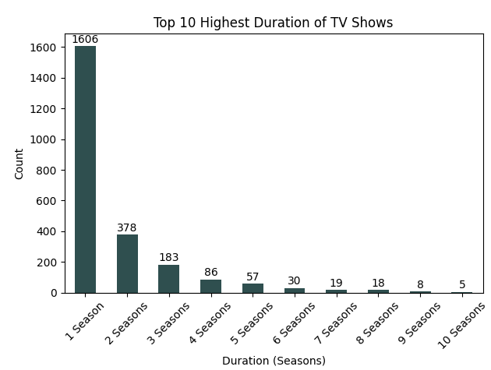
Top 10 Highest Duration of Shows : Movies vs Tv Shows
KEY BUSINESS INSIGHTS
Standard 90-Minute Window
The vast majority of movies cluster tightly between 88 to 98 minutes, with 90 minutes (136 titles) and 93 minutes (131 titles) being the most common lengths for casual viewing.
Heavy Reliance on 1-Season Shows
Single-season titles (1,606 shows) massively dominate the platform, while only a small fraction of series successfully cross 3 or more seasons.

Slide 13
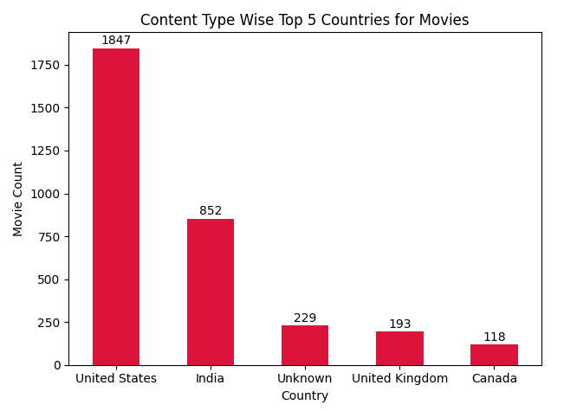
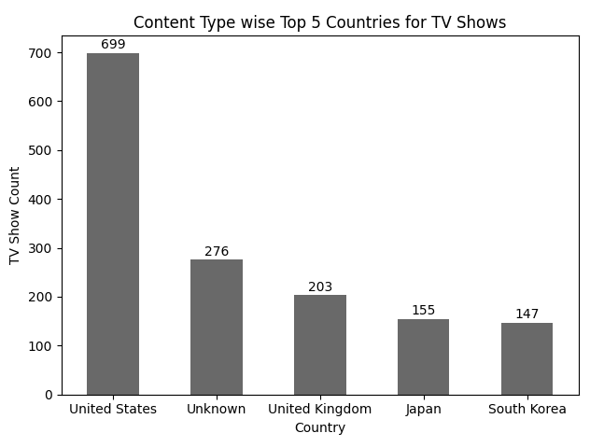
Top Content Producing Countries: Movies vs. TV Shows
KEY BUSINESS INSIGHTS
US & India Lead Film Catalogue
The United States (1,847) and India (852) heavily dominate the movie library, while the UK (193) and Canada (118) provide smaller Western support alongside 229 unclassified titles.
US on Top with East Asian Presence
The United States (699) and the UK (203) lead Western series, while Japan (155) and South Korea (147) secure strong global representation alongside 276 unclassified titles.

Slide 14
CONCLUSION
More Movies than TV Shows: Movies make up nearly 70% of the entire library, with most films running around 90 minutes. TV shows, on the other hand, mostly stick to just 1 season.
Focus on Mature Viewers: Most titles fall under TV-MA and TV-14 ratings, showing that Netflix clearly targets teens and adult audiences rather than kids.
US & India Lead the Library: The United States and India produce the highest volume of movies, while East Asian content (Anime and K-dramas) drives massive global TV viewing.
Peak Growth Around 2019–2020: Content additions hit an all-time high between 2019 and 2020 before Netflix started focusing more on quality original shows over sheer quantity.

Slide 15
THANK YOU

